Slide 1

LFA 2 Strengthening Assessment Design
2.1 Investigation: Part A Booklet – What are students seeking from their assessments?

Slide 2
LFA 2.1 Part A - Contents
Contents of LFA2 2.1 Investigation: Part A Booklet
An overview of LFA 2 Investigation: Part A…………………..
Guides and scaffolds to support each part of the investigation
  A Learning Conversation Guide that can be adapted to suit the students involved……………………………
  A note-taking scaffold for Focus Group Recorders…..
  An analysis and synthesis template to document what has been learned from each Focus Group Learning Conversation…………………………………………….
  A template to collate the findings from each Learning Conversation, with broader analysis across all findings………………………………………………………………
page 3
page 4
page 5
page 7
page 8

Slide 3
LFA 2.1 Part A - Overview
Overview of LFA2 Investigation: Part A
The Investigation Team (1 school leadership team member, 3-5 teacher leaders and 6-10 teachers) prepare for the investigation. This means:
  Becoming familiar with the guides and scaffolds in this booklet – and adapting language to better suit local contexts where appropriate. Ensure everyone is clear about the investigation process.
  Pairing teachers (a conversation lead and a recorder) to conduct and guide the Student Focus Group to share current experiences of assessment in the school.
  Identifying a diverse group of students from different year levels/cohorts to make up the Student Focus Group.
Teacher leaders follow up with their teachers to confirm the students who will participate in the Learning Conversation Focus Group. They provide support for the logistics, such as, teacher release/cover; student release; scheduling time to undertake the conversations and the follow up sense-making and small team analysis.
Teachers can choose students from either class, regardless of who is the Conversation Lead. Teachers prepare by thinking about follow-up questions to tease out responses beyond what students initially offer in response to the questions on p.4. The recorder can contribute to the questioning or clarifying as they notice something that could be further pursued.
Teacher Leaders lead the first synthesis and analysis conversation with their team of two teachers, using the scaffold on p.5 to make sense of what has been discovered.
The Investigation Team reconvene and discuss findings in light of the Student Focus Group discussions – recording this on p.6.

Slide 4
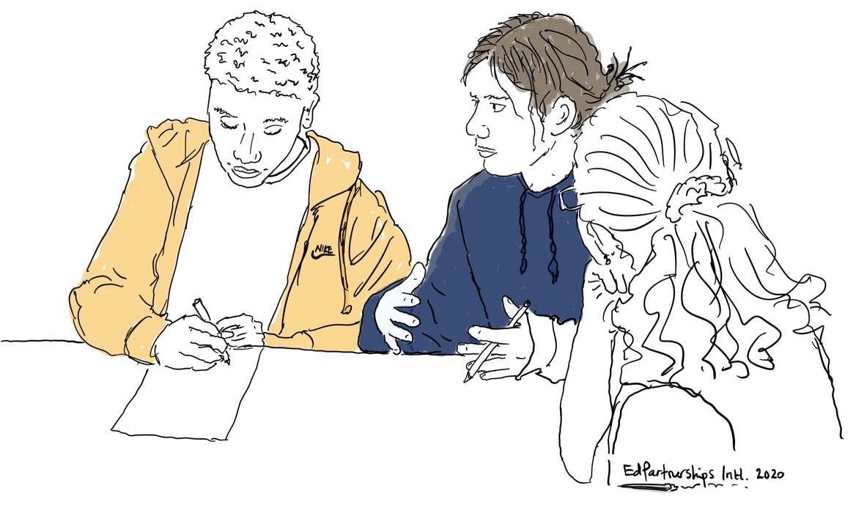
LFA 2.1 Part A – Learning Conversation Guide
LFA 2 Investigation Part A
Student Focus Group - Learning Conversation Guide
The following questions are offered as a guide – feel free to adapt them to better suit the age of the students in your focus group and the needs of your local context:
What would you like to know more about in relation to your learning progress?
What has helped you the most to understand the progress you are making?
What suggestions do you have for getting better at knowing how you are going in your learning?
When you think about the kinds of assessments you do, which ones help you to reveal what you know, understand and can do more accurately?
Jot down notes during (or straight after) the conversation. Try to capture as accurately as possible in the voice of your research partners. You may wish to record this conversation on your phone or other device as a back-up or to revisit later. You will have an opportunity to share and collaboratively analyse this with colleagues as part of the research process.

Slide 5
LFA 2.1 Part A – Learning Conversation Notes
Note Taking Template for LFA 2 Investigation Part A – Learning Conversation with a Student Focus Group
1. What did students say they would like to know more about in relation to their learning progress… | 2. What helped them the most to understand the progress they were making was…
3. Their suggestions for getting better at knowing how they were going in their learning were… | 4. The types of assessments they thought helped them to reveal more accurately what they know, understand and can do were…

Slide 6
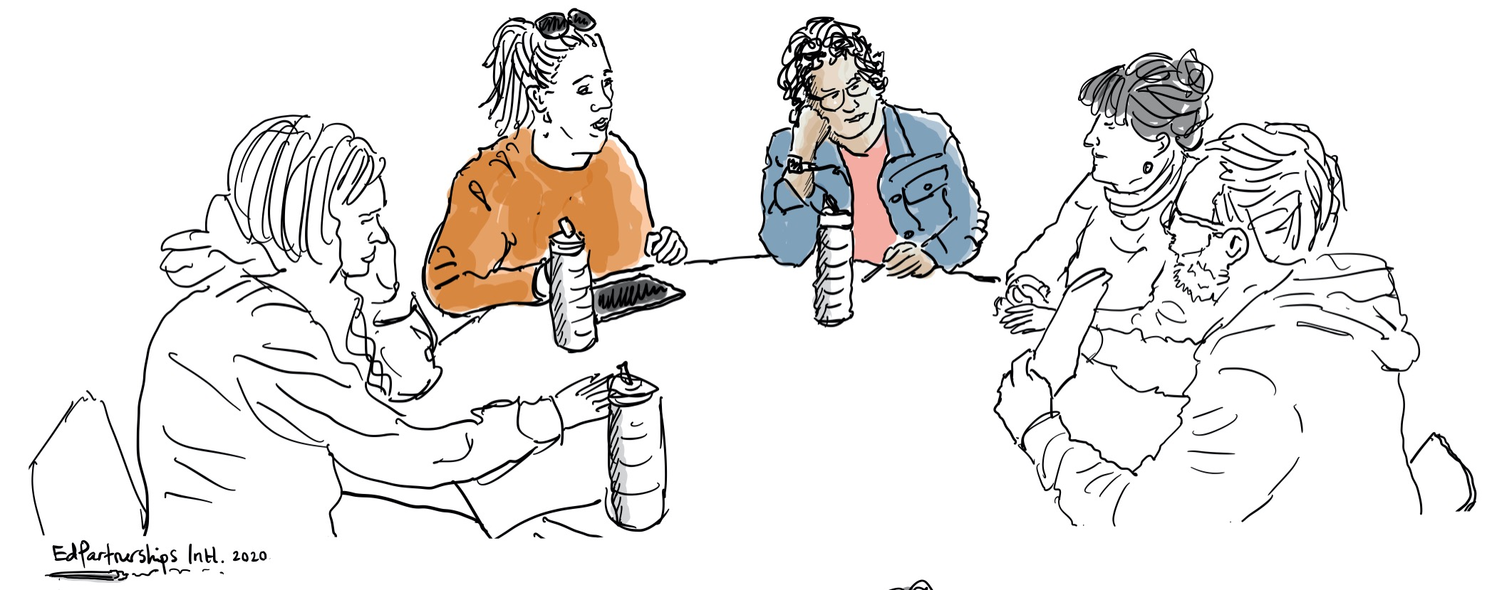
Analysis and Synthesis – Making Sense of our Evidence

Slide 7
LFA 2.1 Part A – Synthesis and Analysis
LFA 2 Investigation Part A - Synthesis and Analysis Scaffold for Individual Focus Group Conversations
Key ideas /themes that emerged?
What is valued by students or considered to be helpful in our approach to assessment?
What is not valued or needs attention / a rethink?
What did you notice about how students positioned themselves – as active in seeking to work out how they are going or reliant on others to let them know? What do you think this means for our school community?
Teacher Leaders facilitate this process with the teachers from their team who engaged in the Learning Conversations with students.

Slide 8
LFA 2.1 Part A – Synthesis and Analysis
LFA 2 Investigation Part A: Synthesis and Analysis Scaffold for Whole Investigation Team
Key ideas /themes that emerged?
What is valued by students or considered to be helpful in our approach to assessment?
What is not valued or needs attention / a rethink?
What did you notice about how students positioned themselves – as active in seeking to work out how they are going or reliant on others to let them know? What do you think this means for our school community?
The Investigation Lead facilitates this process with the whole Investigation Team of teachers and teacher leaders. This is the documentation that will be taken to LFA 4.

